Slide 1

Optimal Power Flow in Power Systems
Mohamed Sadfi, Janick Matter
May 2024

Slide 2
Table of contents
The optimisation problem
Initial approach
Obstacles and adaptions
Results
Discussion and outlook

Slide 3
The Optimisation Problem:
“Find the settings for the generation outputs, which minimizes the overall supply cost, taking into account the power flow equations and operational constraints”

Slide 4
Initial approach
Simulated annealing

Slide 5
Obstacles
Inequality constraints in the optimisation problem

Slide 6
Obstacles and adaptions
Ipopt approach? To handle inequality constraints of the optimal power flow

Slide 7
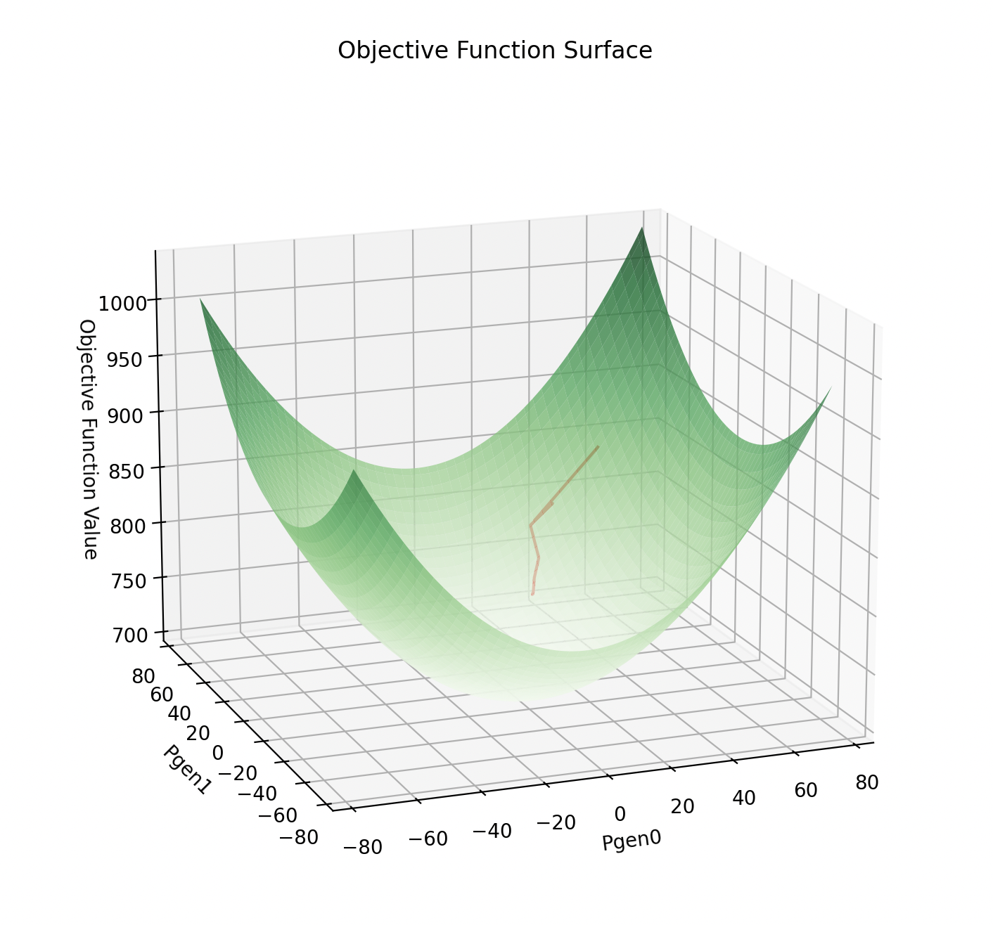
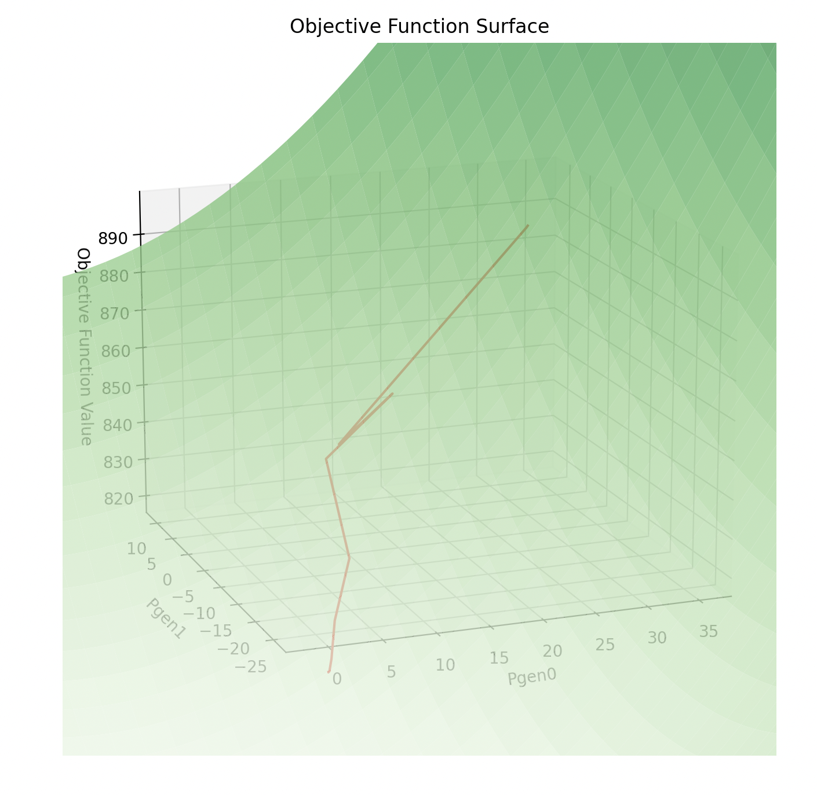
Results: 1st shot – objective function evaluation

Slide 8
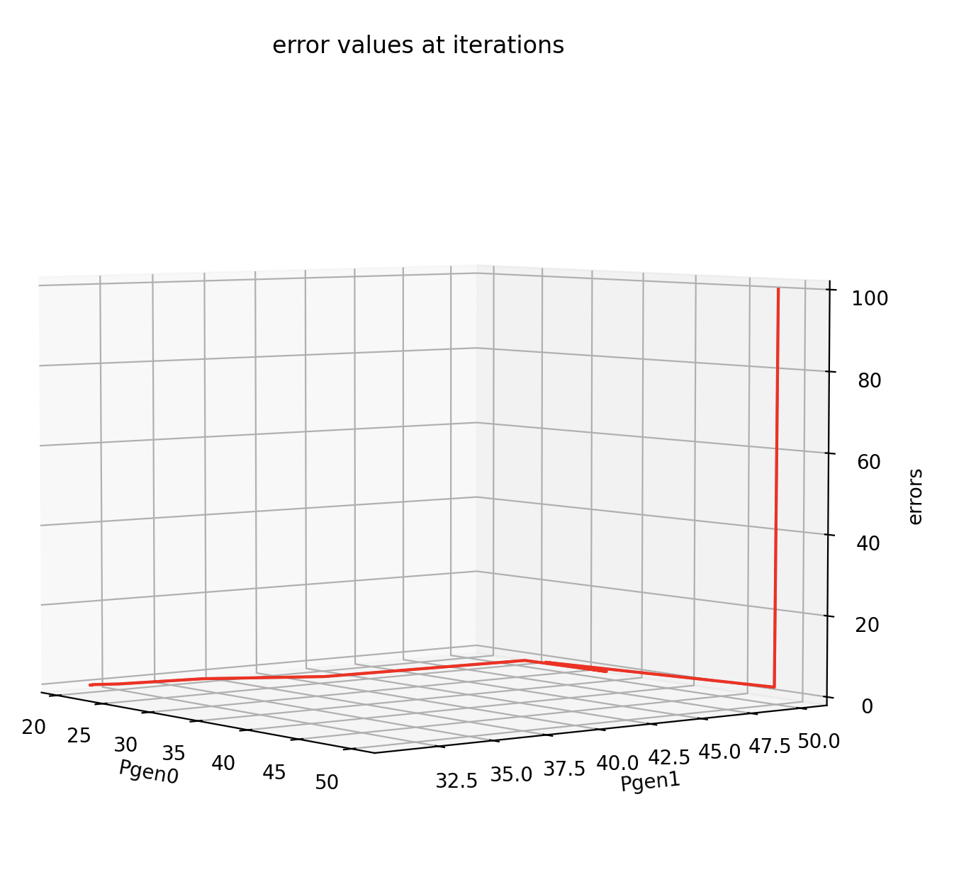
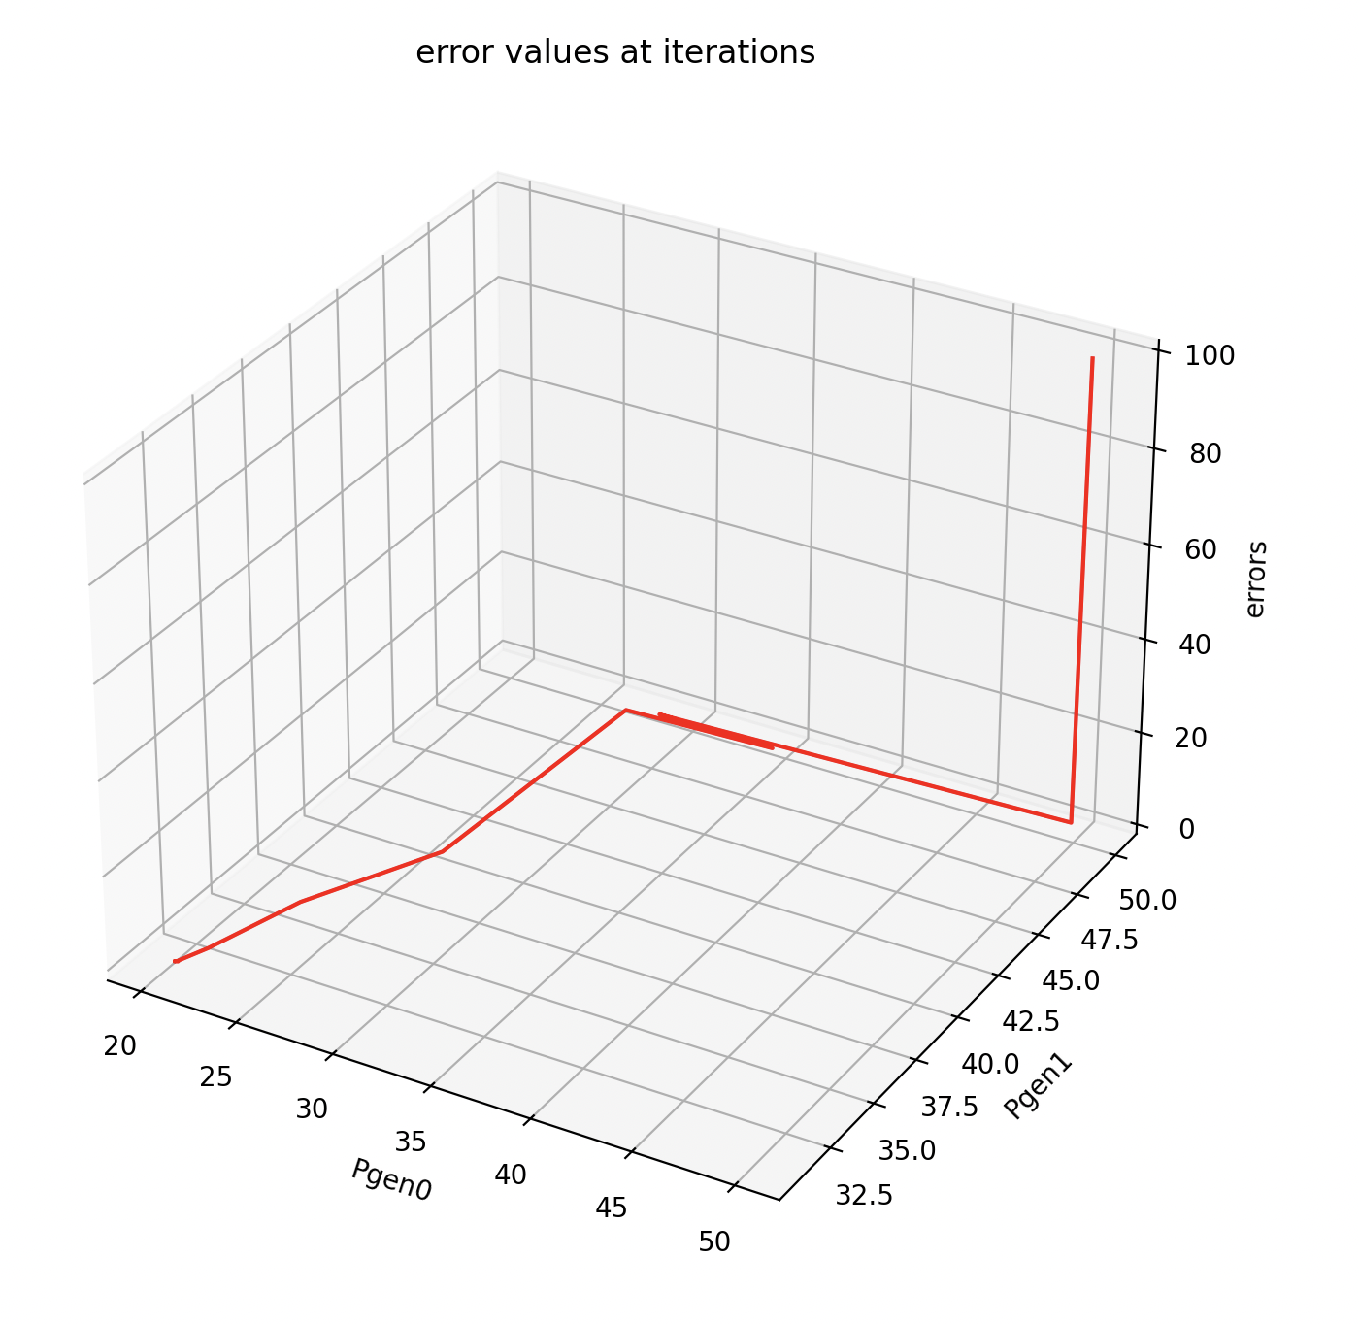
Results: 1st shot - errors

Slide 9
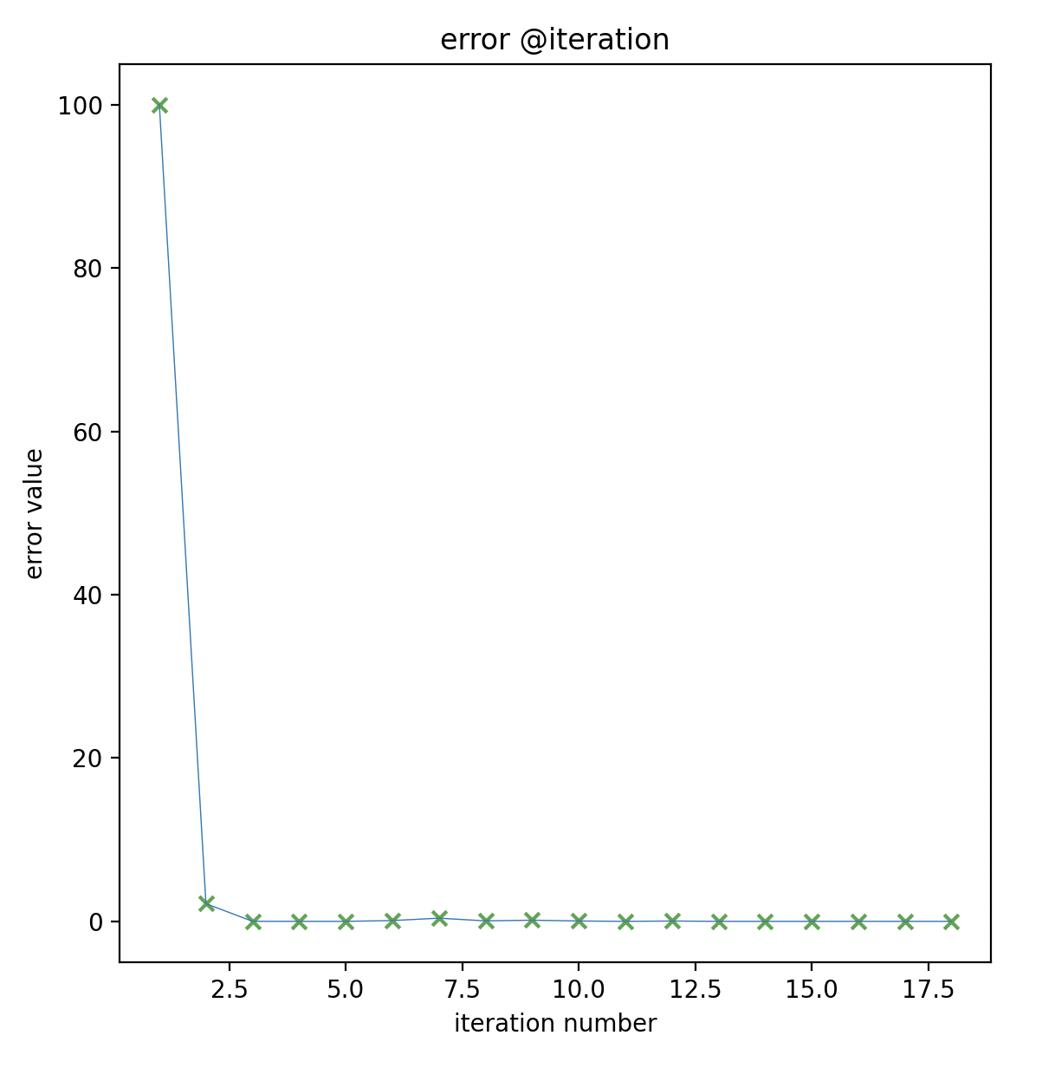
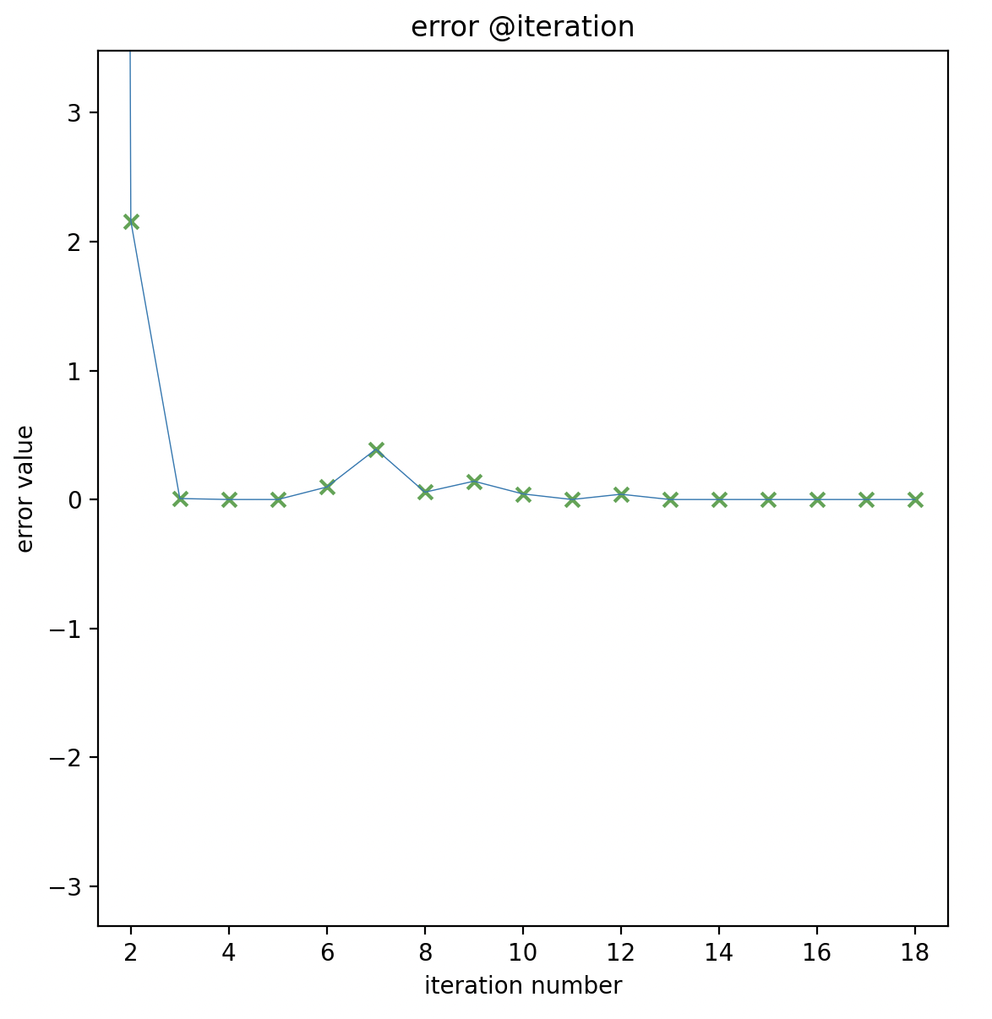
Results: 1st shot – errors vs. iterations

Slide 10
2nd approach: more complex objective function
Tbd ??

Slide 11
Discussion and Outlook
1st shot:
Too fast convergence

